Slide 1
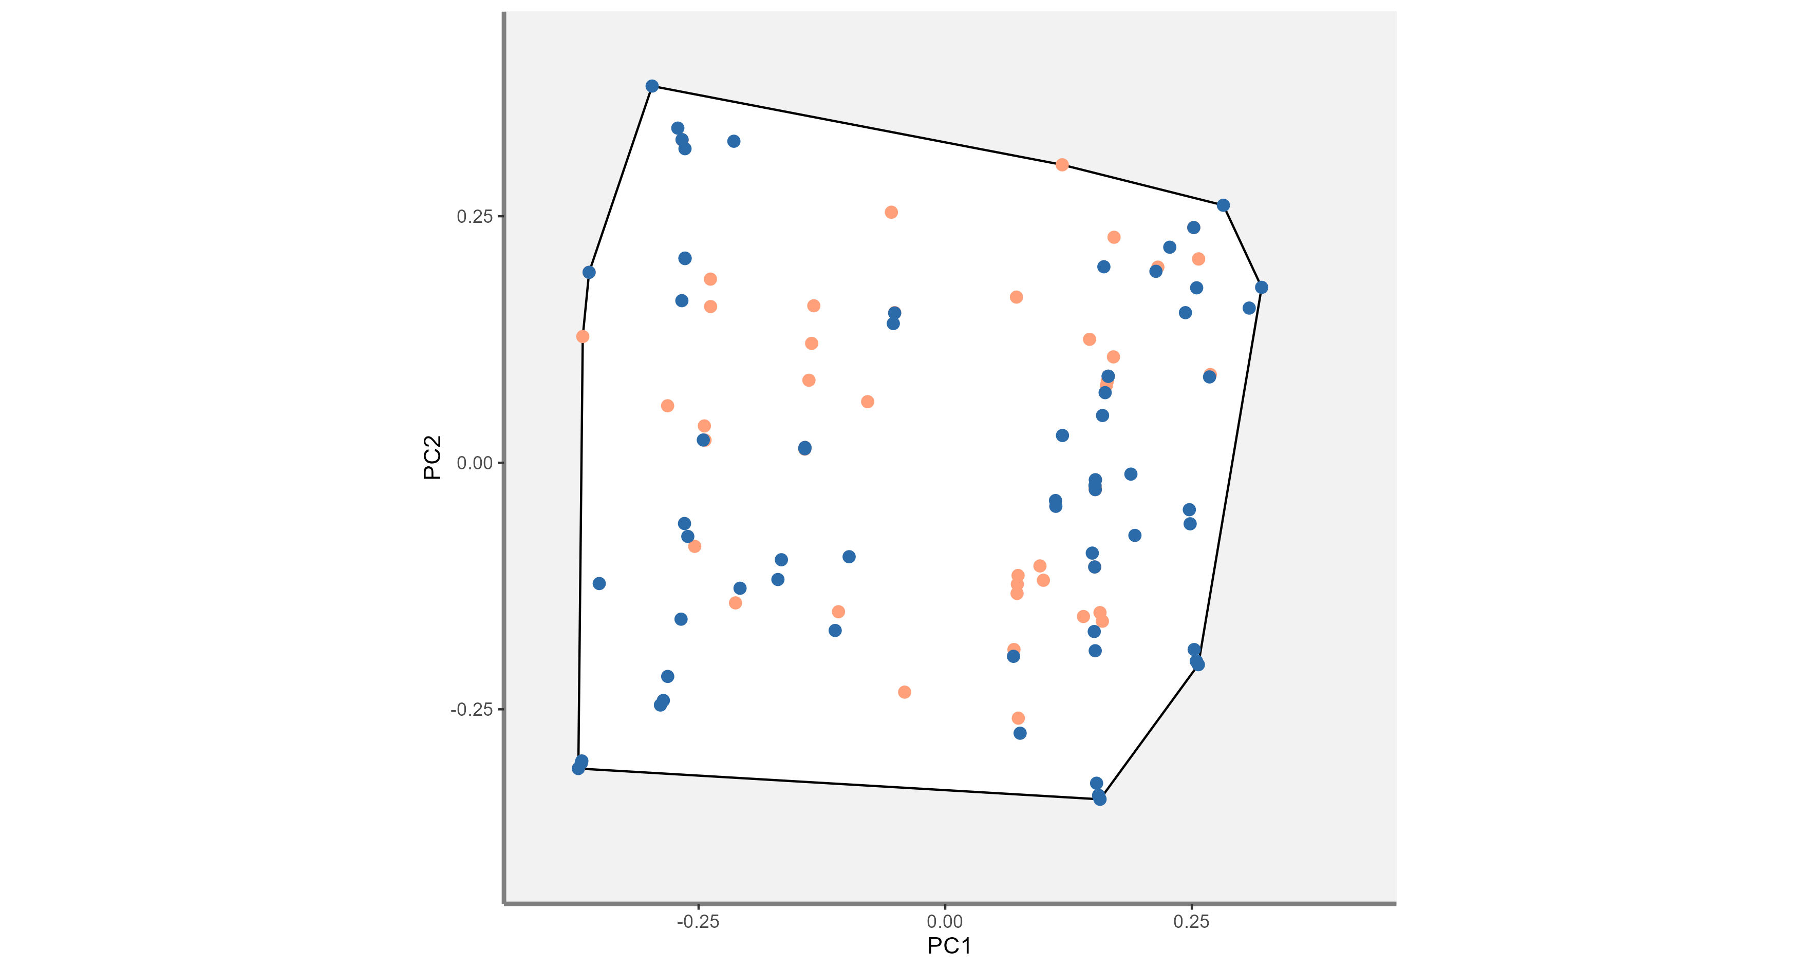
Kmax
Small
Planktivores
Group
Solitary
Kmax
Big
Predators
Pelagic
Benthic

